Slide 1
COVID-19 Cases Prediction

Slide 2
Outline
Objectives
Task Description
Data
Evaluation Metric
Kaggle
Grading
Code Submission
Deadlines
Hints
Regulations again
Useful Links

Slide 3
Objectives
Solve a regression problem with deep neural networks (DNN).
Understand basic DNN training tips
e.g. hyper-parameter tuning, feature selection, regularization, ...
Get familiar with PyTorch.

Slide 4
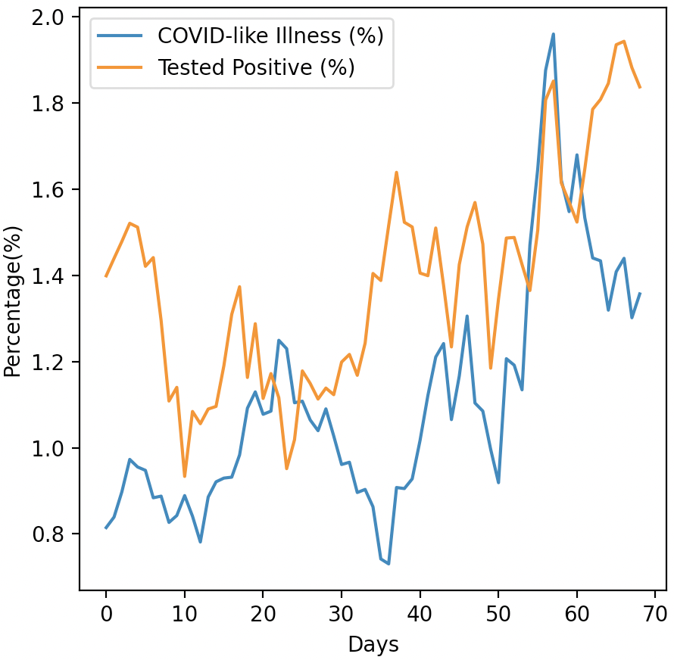
Task Description
COVID-19 Cases Prediction
Source: Delphi group @ CMU
A daily survey since April 2020 via facebook.
Do not attempt to find any related data!
Using additional data is prohibited and your final grade x 0.9 !

Slide 5



Task Description
Given survey results in the past 3 days in a specific state in U.S., then predict the percentage of new tested positive cases in the 3rd day.
survey
positive
cases
survey
positive
cases
survey
positive
cases
Day 1
Day 2
Day 3

Slide 6

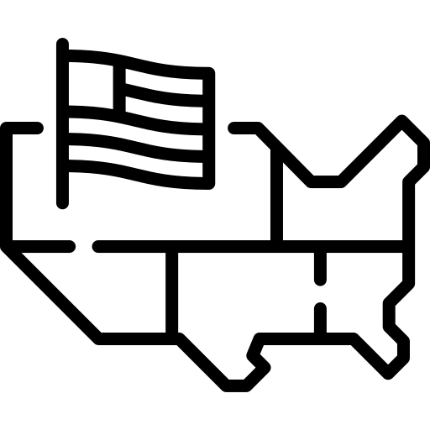
Data -- Delphi's COVID-19 Surveys
Conducted surveys via facebook (every day & every state)
Survey: symptoms, COVID-19 testing, social distancing, mental health, demographics, economic effects, ...

Slide 7




Data -- Delphi's COVID-19 Surveys
estimation for all population in that state
(data we are using)
All population in a certain state of the U.S.
some samples
survey

Slide 8
Data -- Delphi's COVID-19 Surveys
States (40, encoded to one-hot vectors)
e.g. AL, AK, AZ, ...
COVID-like illness (4)
e.g. cli,ili (influenza-like illness), ...
Behavior Indicators (8)
e.g. wearing_mask, travel_outside_state, ...
Mental Health Indicators (5)
e.g. anxious, depressed, ...
Tested Positive Cases (1)
tested_positive (this is what we want to predict)
Percentage

Slide 9

Data -- One-hot Vector
One-hot vectors:
Vectors with only one element equals to one while others are zero.
Usually used to encode discrete values.
AL (Alabama)
AK (Alaska)
AZ (Arizona)
AR (Arkansas)
WI (Wisconsin)
one-hot encoding
If state code = AZ
(Arizona)

Slide 10
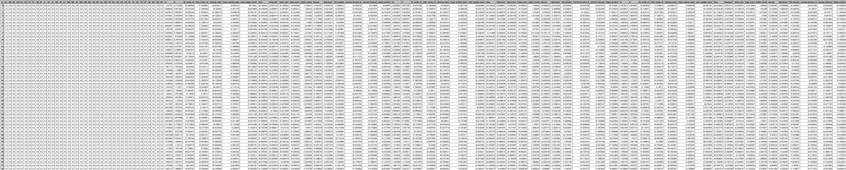
Data -- Training
covid.train.csv (2700 samples)
state one-hot encoding (40)
Day 1 features
(18)
Day 2 features
(18)
Day 3 features
(18)
tested
positive
1 row = 1 sample

Slide 11
Data -- Testing
covid.test.csv (893 samples)
state one-hot encoding (40)
Day 1 features
(18)
Day 2 features
(18)
Day 3 features
(17)
1 row = 1 sample

Slide 12
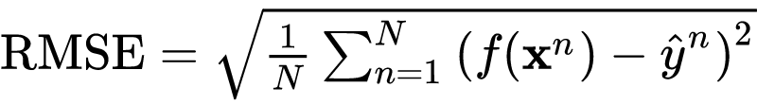
Evaluation Metric
Root Mean Squared Error (RMSE)
your model
ground truth label
(correct answer)
input features
(testing data)

Slide 13
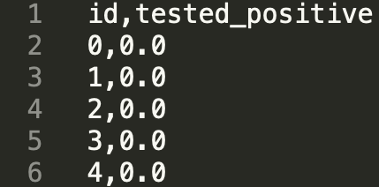
Kaggle
Link: https://www.kaggle.com/c/ml2021spring-hw1 (not launched yet)
Displayed name: <student ID>_<anything>
e.g. b06901020_puipui
For auditing, don’t put student ID in your displayed name.
Submission format: .csv file
See sample code

Slide 14
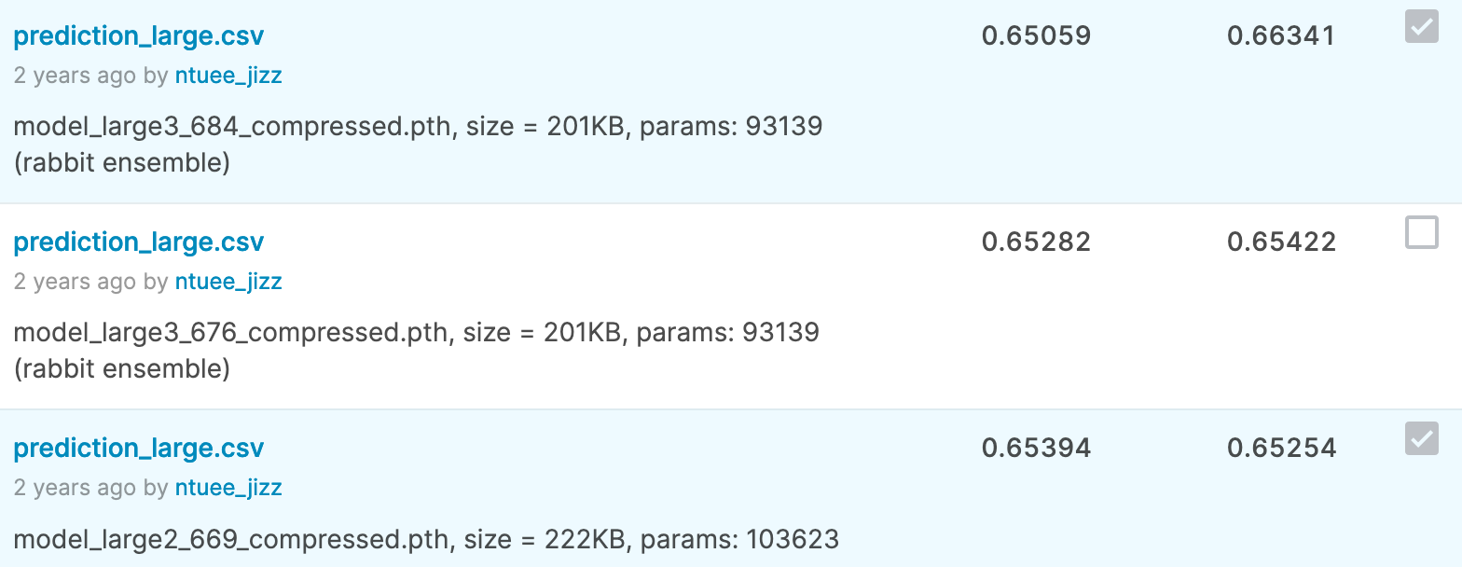
Kaggle -- Submission
You may submit up to 5 results each day (UTC).
Up to 2 submissions will be considered for the private leaderboard.
remember to select 2 results for your final scores before the competition ends!

Slide 15
Grading
Simple baseline (public) +1 pt (sample code)
Simple baseline (private) +1 pt (sample code)
Medium baseline (public) +1 pt
Medium baseline (private) +1 pt
Strong baseline (public) +1 pt
Strong baseline (private) +1 pt
Upload code to NTU COOL +4 pts
Total: 10 pts

Slide 16
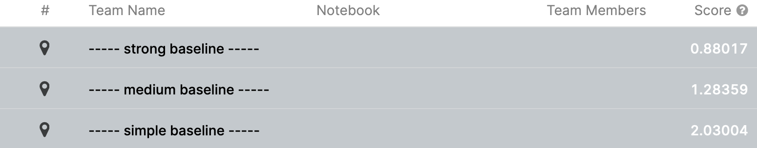
Grading -- Kaggle
We might change the strong baseline if it’s too hard.

